Slide 1

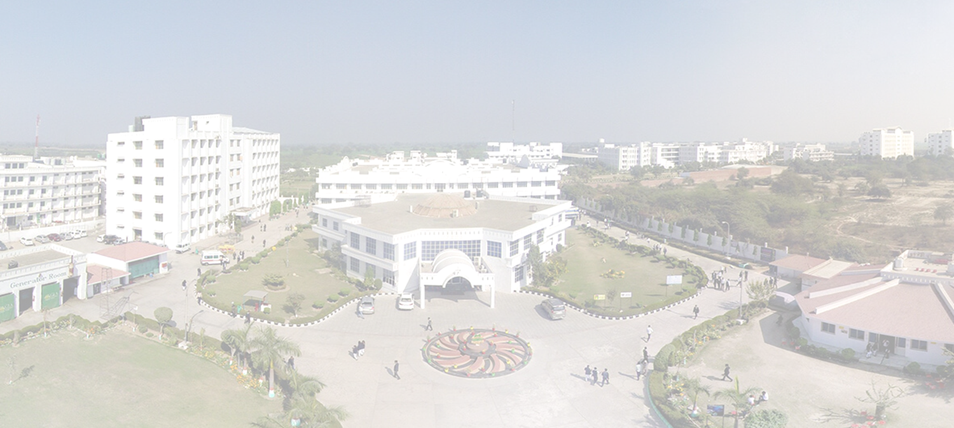
GLA UNIVERSITY
PROJECT PRESENTATION
Under the guidance of-
Mr. Sandeep Kumar Chhoker
Technical Trainer

Slide 2
A PRESENTATION ON ‘MINI MINDS’ QUIZ WEBSITE

Slide 3
PRESENTED BY :-
Anshu Pathak (C) 2115000166
Bhoovan Kumar (C) 2115000299
Gaurav Prajapati (H) 2115000405
Shivam Gupta (C) 2115000947

Slide 4
Welcome to
Mini Minds!
Quiz for Kids

Slide 5
Introduction

Slide 6
The ultimate quiz destination for young explorers! 🚀🧠
At Mini Minds, we've created a space where learning is an adventure.
Our quizzes are designed to spark curiosity and make knowledge exciting for kids.

Slide 7
From fascinating facts to mind-bending puzzles, Mini Minds is where little minds thrive!
Let's dive into a world of fun learning.
Are you ready to embark on a quiz-tastic journey?
Let the Mini Minds adventure begin! 🌟

Slide 8
Objective

Slide 9
Develop an engaging Mini Minds Game website for kids to make learning enjoyable.
Provide age-appropriate, interactive, and educational content in a safe online environment.
Prioritize user-friendly design, continuous improvement.

Slide 10
WHY WE MADE THIS PROJECT?

Slide 11
This college project was initiated with a strong emphasis on personal growth and skill enhancement. By actively engaging in the creation and execution of this project, our primary goal was to elevate our individual and collective capabilities, allowing us to leverage this experience for continuous self-improvement and practice in our academic journey.

Slide 12
Methodology

Slide 13
Front-end:
HTML: For creating the structure and content of your web pages.
CSS: For styling the user interface, making it visually appealing and child-friendly.
JavaScript: To add interactivity, implement quiz features and result mechanisms.

Slide 14
Back-end:
Server-Side Language: Chose Node.js to handle server-side logic.
Database(will implement in future): Use a database system like MySQL, PostgreSQL, or MongoDB to store user profiles, quiz data, and progress tracking information.
Server Hosting: Select a web hosting service or cloud platform to host your server-side code and database.

Slide 15
SOME CODE SNIPPETS

Slide 16
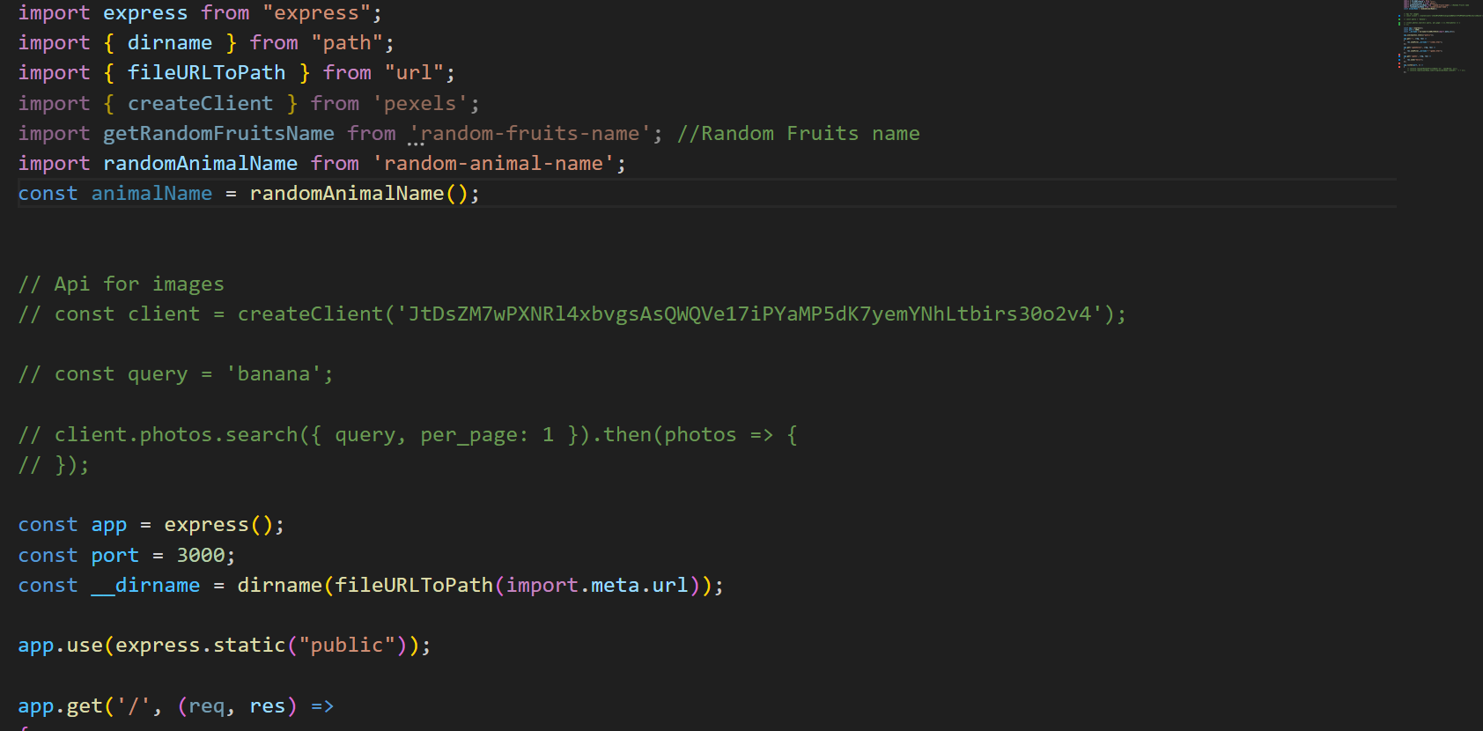

Slide 17
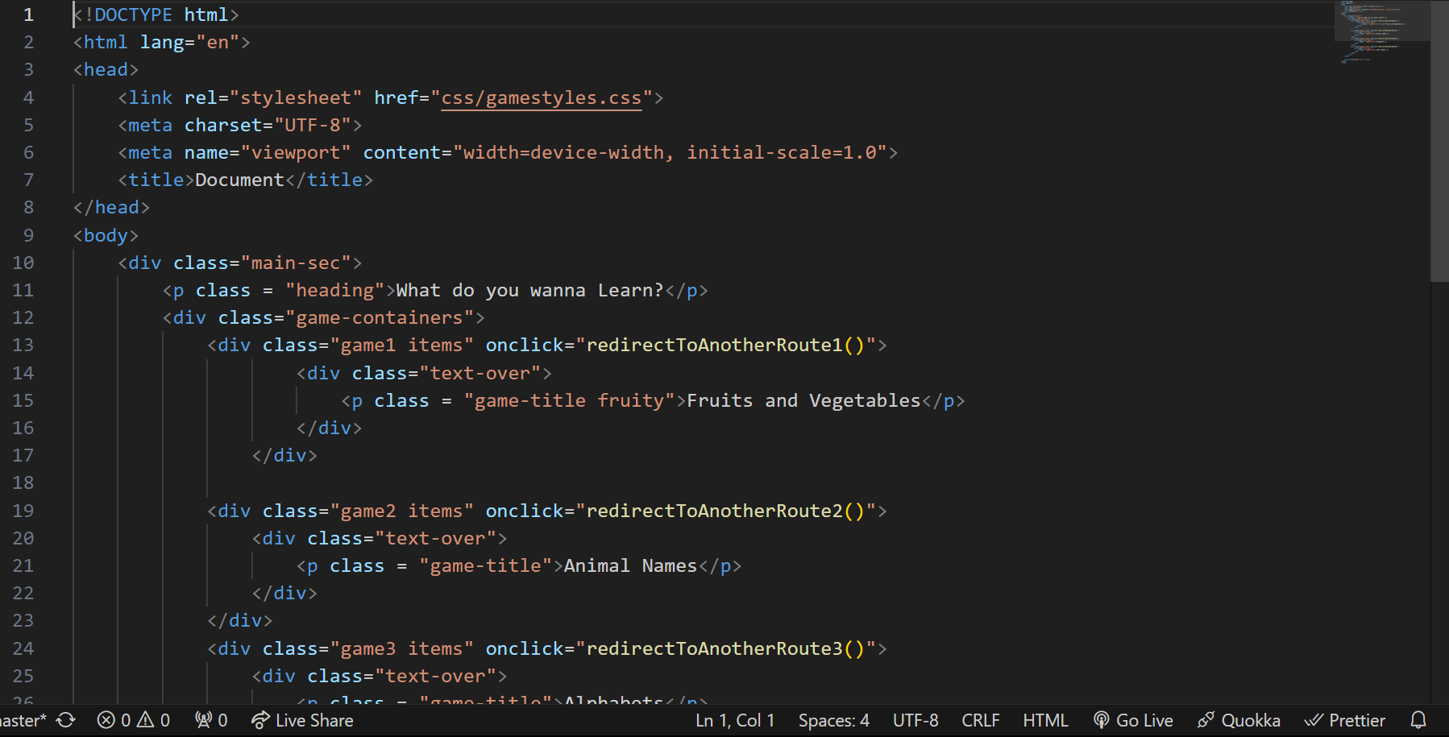

Slide 18
Let's see some gameplays visually

Slide 19
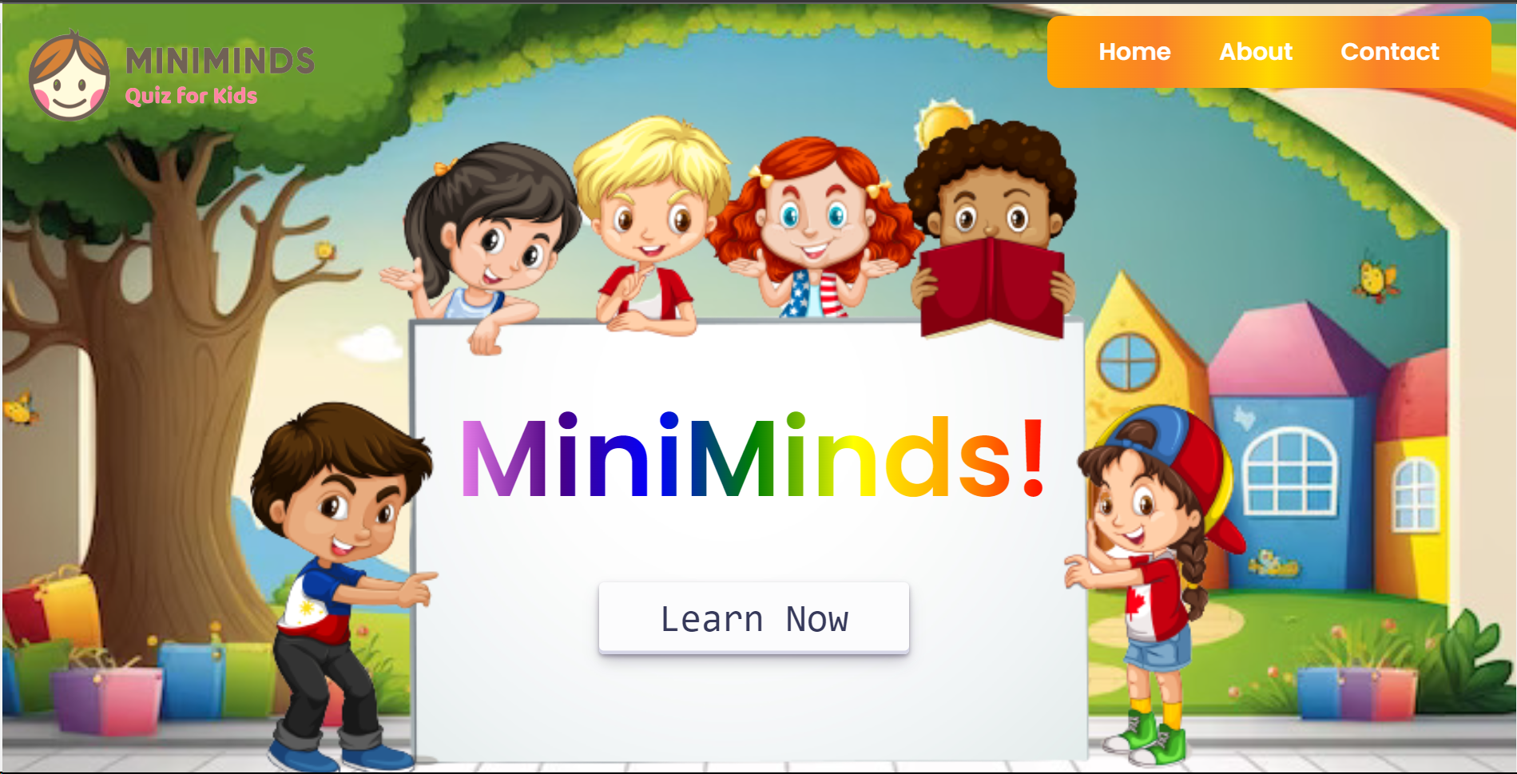

Slide 20
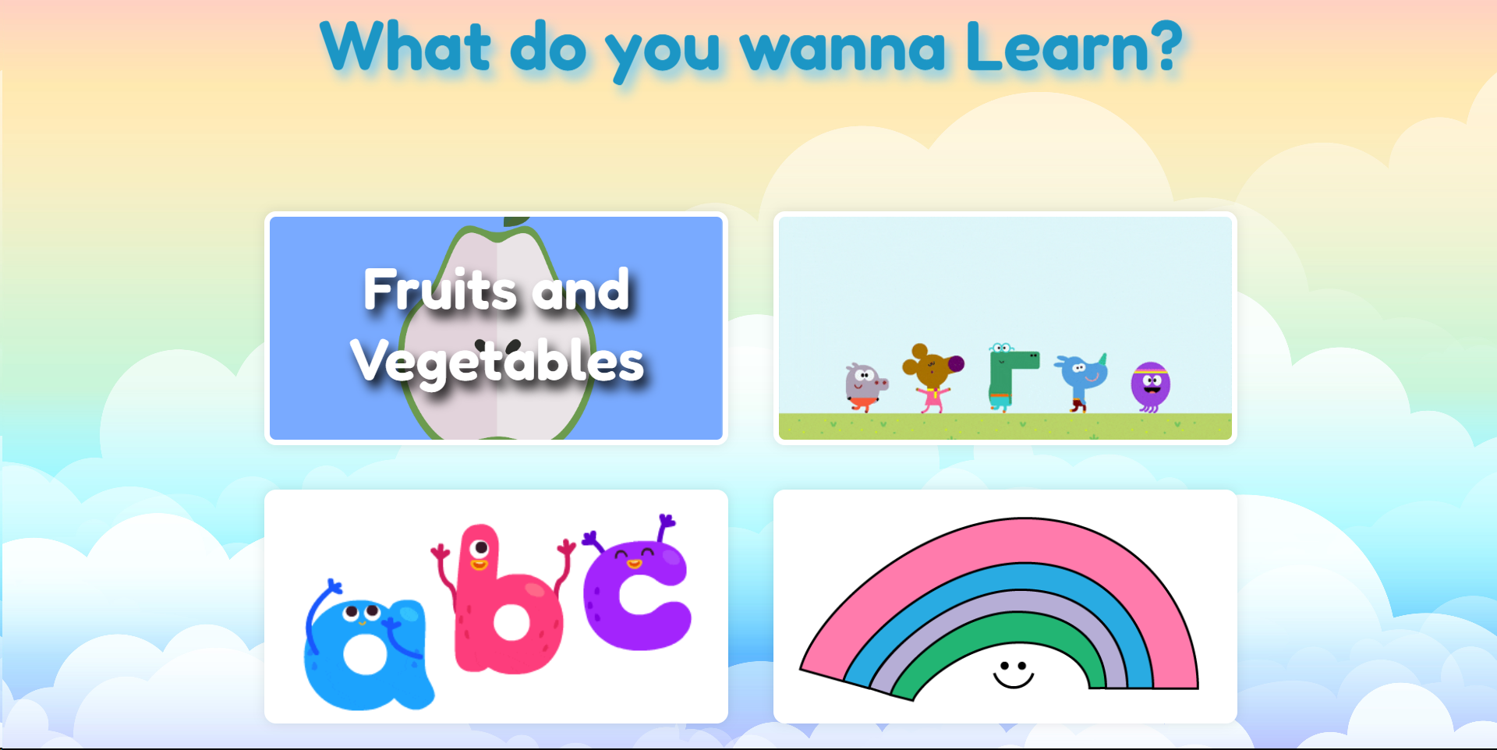

Slide 21
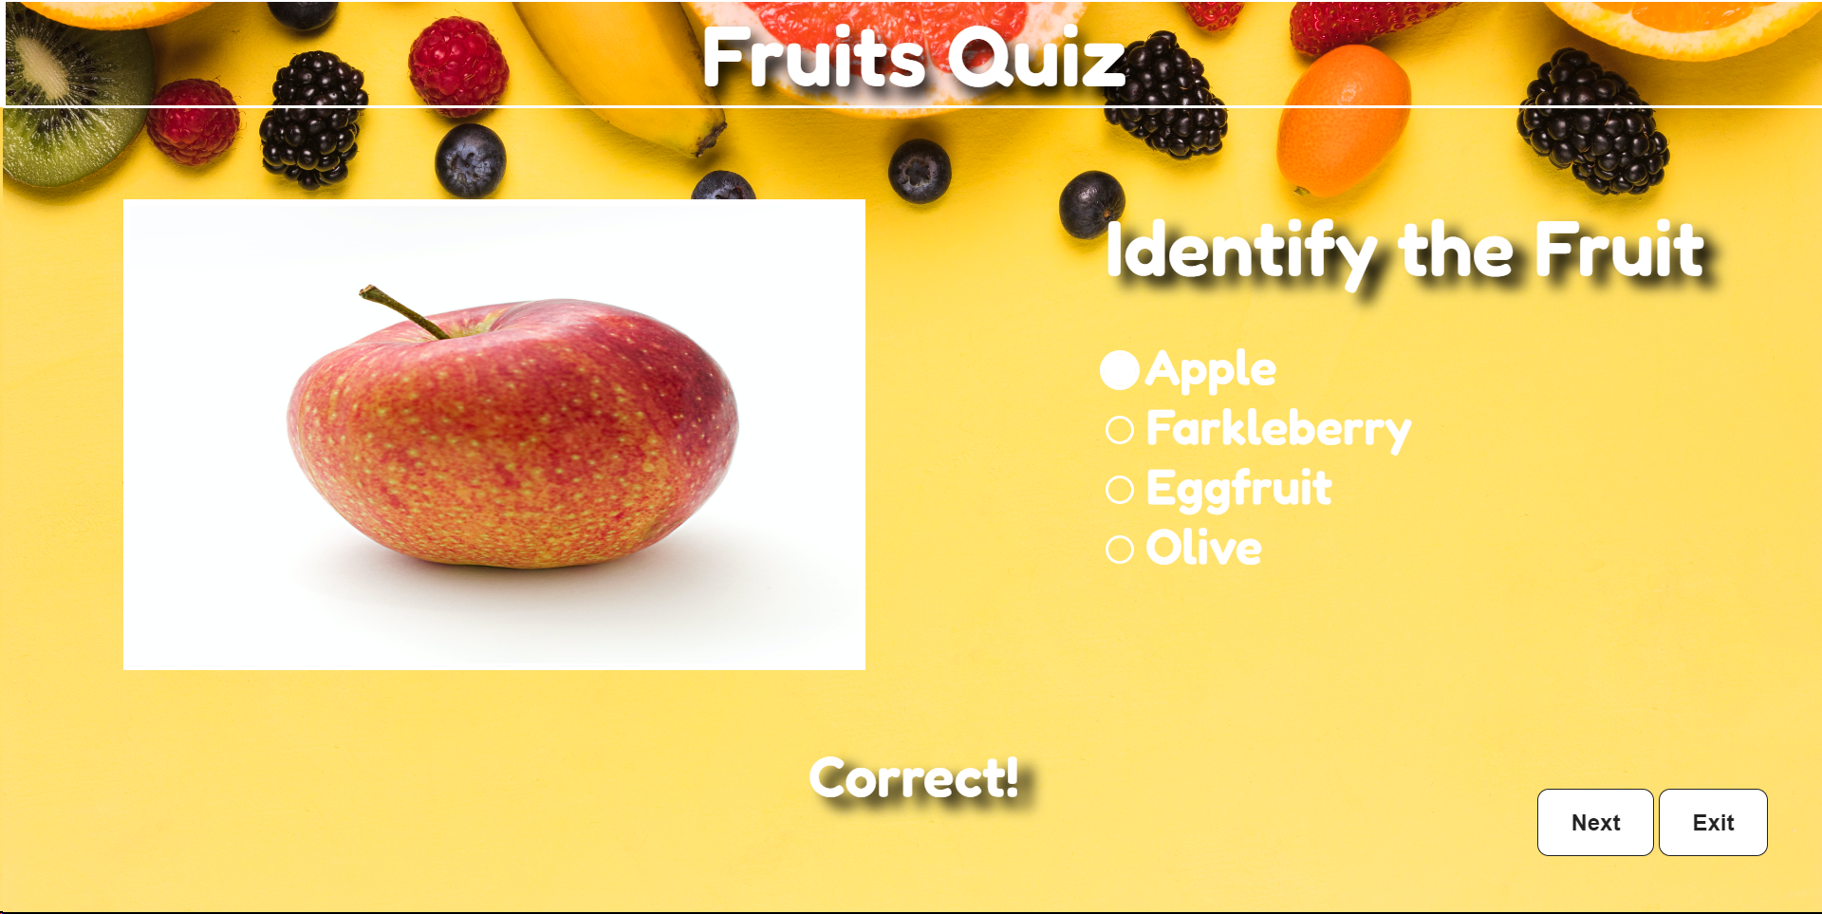

Slide 22
SOME DESCRIPTION ABOUT THE PROJECT

Slide 23
Getting Started:
Visit the Mini Minds Game website.
Game Selection:
Browse through the variety of mini-games available on the platform. Select a game based on your child's interests or choose one that aligns with specific learning goals.
Remember, the primary goal is to create a positive and educational experience for your child.

Slide 24

Click on the ‘Learn Now’ Button to open the quiz option

Slide 25
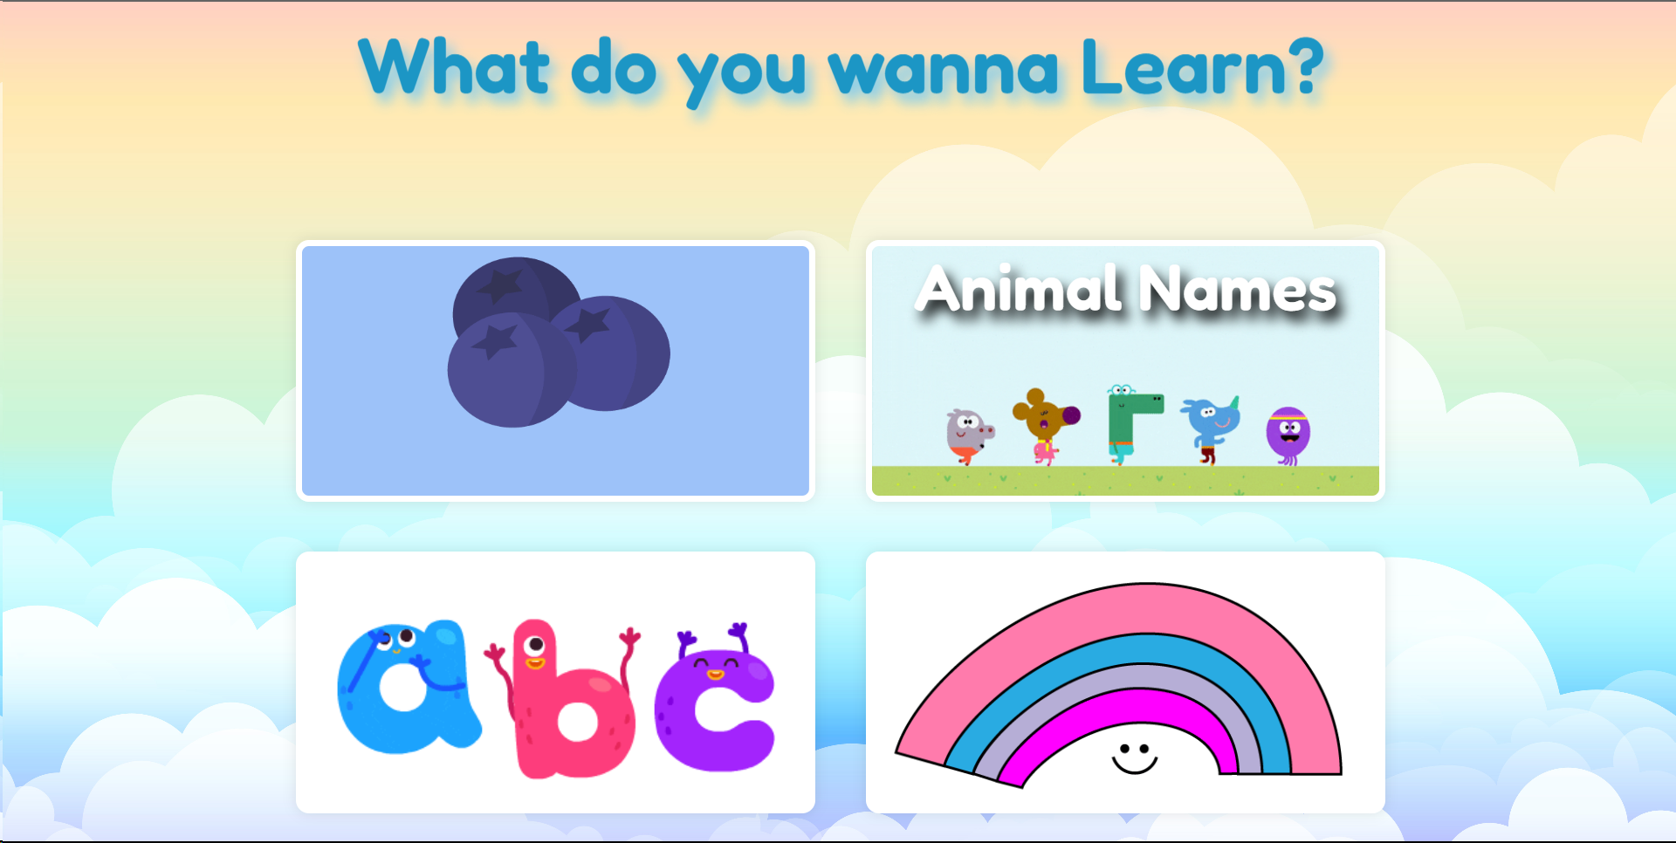
Now, Click on any Card to open that quiz

Slide 26
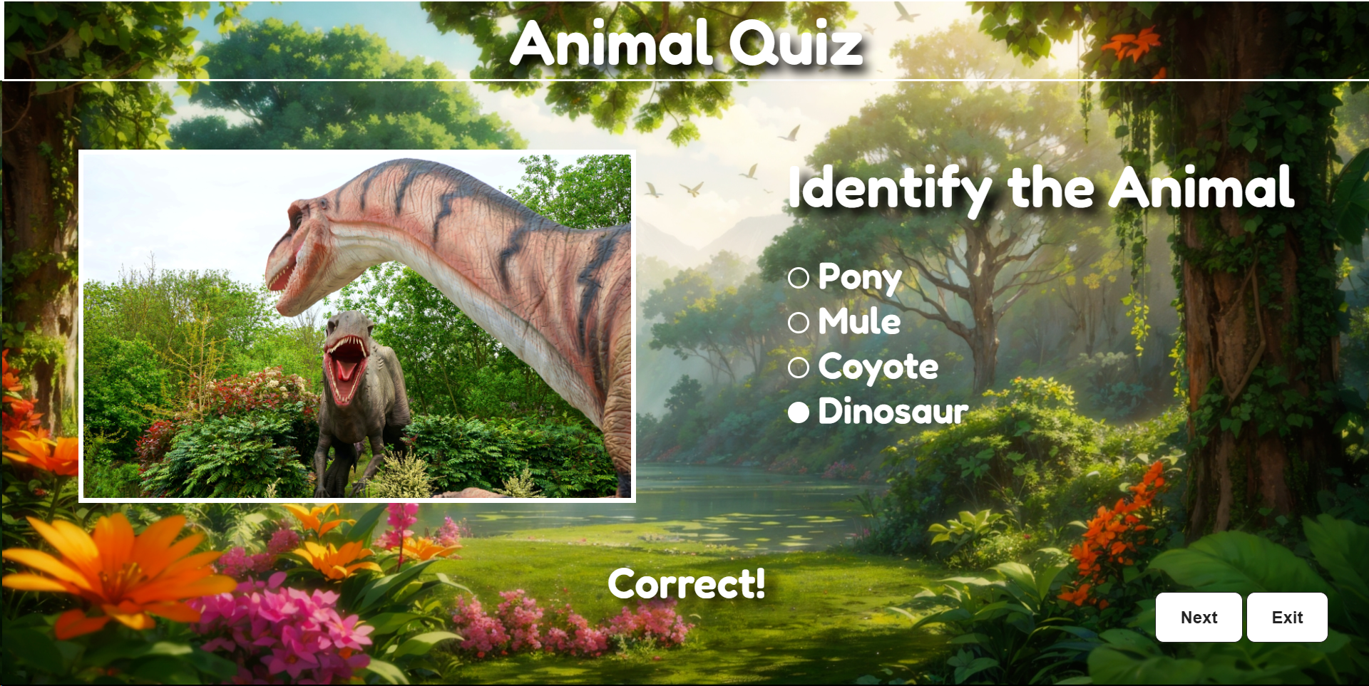
Now click on appropriate option , then instantly you can see the result on the bottom of the screen
And then click on ‘Next’ Button for next Question

Slide 27
FUTURE WORKS
DataBase :- to save user’s progress.
Scoring System :- so that user can see their improvement/results.
New Quiz/Games :- will be added.

Slide 28
Summary

Slide 29
Mini Minds is an engaging quiz website designed for kids, offering a fun and interactive platform to ignite curiosity and learning through a diverse range of captivating quizzes, puzzles, and educational challenges.

Slide 30
THANKS!
Many

